Slide 1
Introduction to Computer Networks
Topic 1B

Slide 2
Learning Outcomes
By the end of this lesson, you should be able to:
1. Explain the fundamentals of network communication
2. Define common networking terms
3. Compare different network models

Slide 3
The Fundamentals of Network Communication
A computer network consists of two or more computers connected by some kind of transmission medium
Such as a cable or air waves
In order to access the Internet, a computer has to be able to connect to a network
The next few slides will cover what is required to turn a standalone computer into a networked computer

Slide 4
Network Components
Hardware components needed to turn a stand-alone computer into a networked computer:
Network interface card is an add-on card plugged into a motherboard expansion slot that provides a connection between the computer and the network
Network medium is a cable that plugs into the NIC and makes the connection between a computer and the rest of the network
Network media can also be the air waves, as in wireless networks
Interconnecting device allows two or more computers to communicate on the network without having to be connected directly to one another

Slide 5
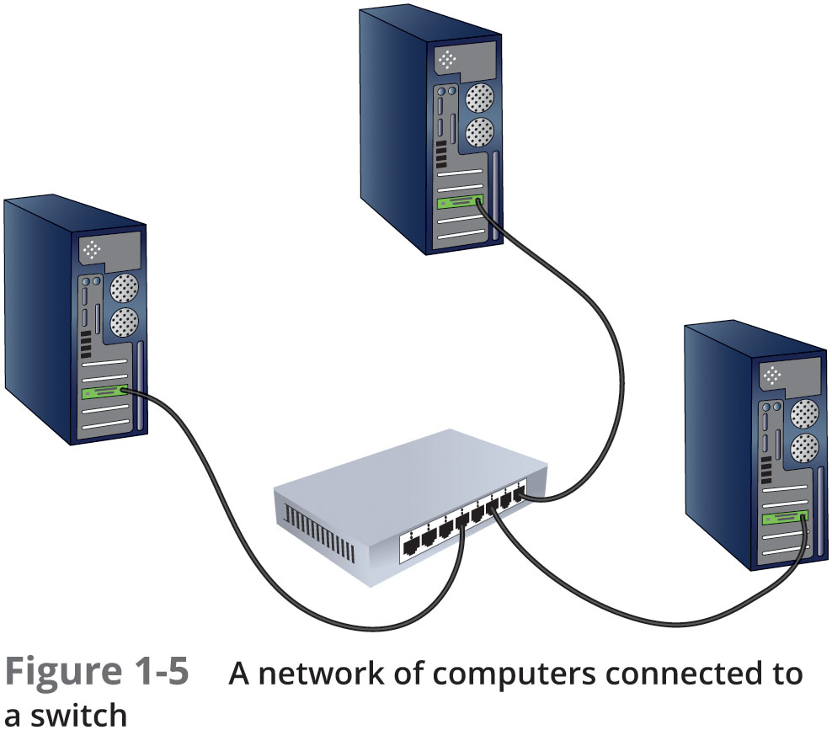
Network Components

Slide 6
Network Components
Network software can be divided into the following categories:
Network clients and servers
Network client software requests information stored on another network computer or device
Network server software allows a computer to share its resources
Protocols
Network protocols define the rules and formats a computer must use when sending information across the network
Network Interface Card driver
NIC drivers receives data from protocols and forwards this data to the physical NIC

Slide 7
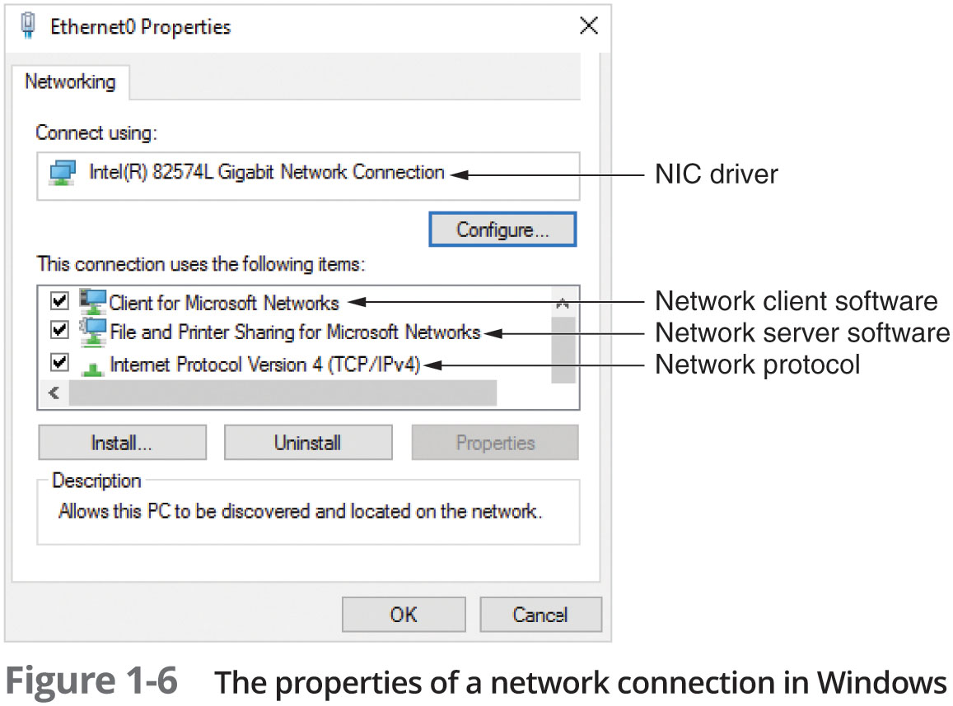
Network Components

Slide 8
Steps of Network Communication
Application tries to access a network resource by sending a message
Client software formats the message and passes the message on to the network protocol
Protocol packages the message in a format suitable for the network and sends it to the NIC driver
NIC driver sends data in the request to the NIC card to be converted into necessary signals to be transmitted on the network
Steps taken at the server side are essentially the reverse of those on the client side

Slide 9
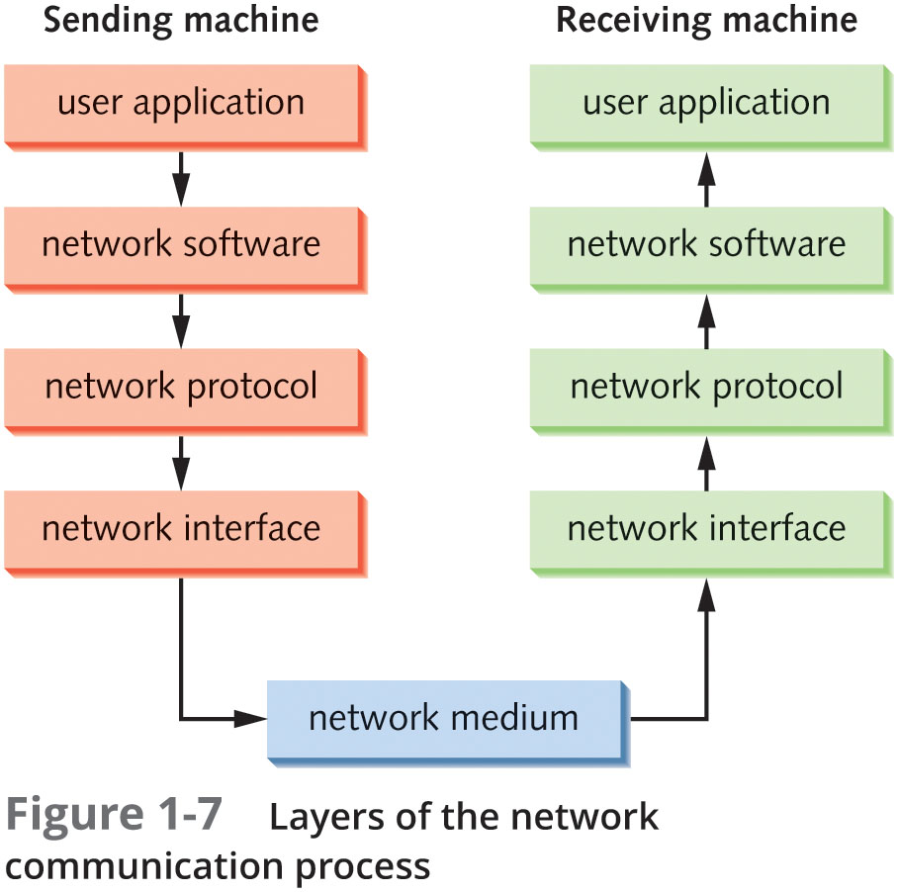
Layers of the Network Communication Process
Each step required for a client to access network resources is referred to as a “layer”
Each layer has a task and all layers work together
Figure 1-7 depicts this process

Slide 10
Layers of the Network Communication Process
Step | Layer | Description
1 | User application | An application tries to access a network resource.
2 | Network client or server software | Client software detects the attempt to access the network and passes the message on to the network protocol.
3 | Network protocol | The protocol packages the message in a format suitable for the network and sends it to the NIC driver.
4 | Network interface | The NIC driver sends the data in the request to the NIC, which converts the data into the necessary signals to be transmitted across the network medium.
Steps to map network resources

Slide 11
How Two Computers Communicate on a Local Area Network (LAN)
TCP/IP is the most common protocol (language) used on networks
TCP/IP uses 2 addresses to identify devices
Logical address (IP address)
Physical address (MAC address)
Just as a mail person needs an address to deliver mail, TCP/IP needs an address in order to deliver data to the correct device on a network
Think of the Logical address as a zip code and the Physical address as a street address

Slide 12
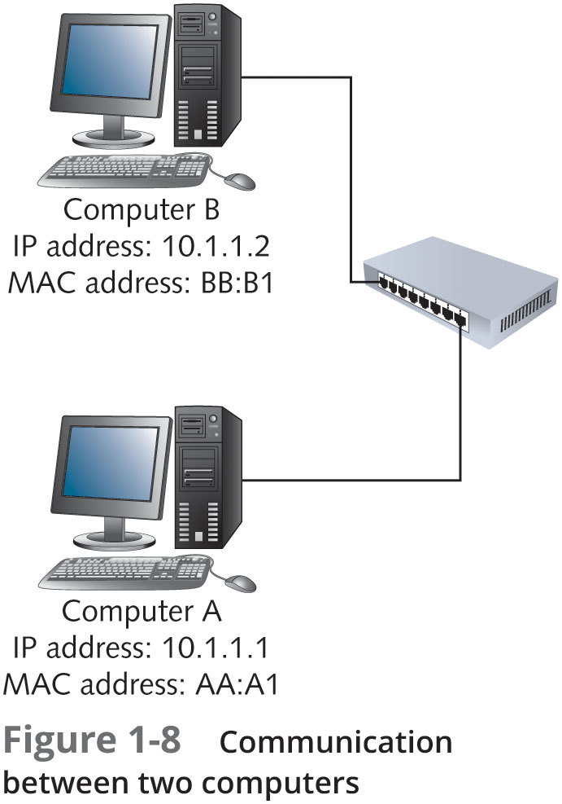
How Two Computers Communicate on a Local Area Network (LAN)
A user at Computer A types ping 10.1.1.2 at a command prompt
Network software creates a ping message
The network protocol packages the message by adding IP address of sending and destination computers and acquires the destination computer’s MAC address
The network interface software adds MAC addresses of sending and destination computers
Computer B receives message, verifies that the addresses are correct and then sends a reply to Computer A using Steps 2 – 4

Slide 13
LANs, Internetworks, WANs, and MANs
Local area network (LAN) is a small network, limited to a single collection of machines and connected by one or more interconnecting devices in a small geographic area
An internetwork is a networked collection of LANs tied together by devices such as routers
Reasons for creation:
Two or more groups of users and their computers need to be logically separated but still need to communicate
Number of computers in a single LAN has grown and is no longer efficient
The distance between two groups of computers exceeds the capabilities of most LAN devices

Slide 14
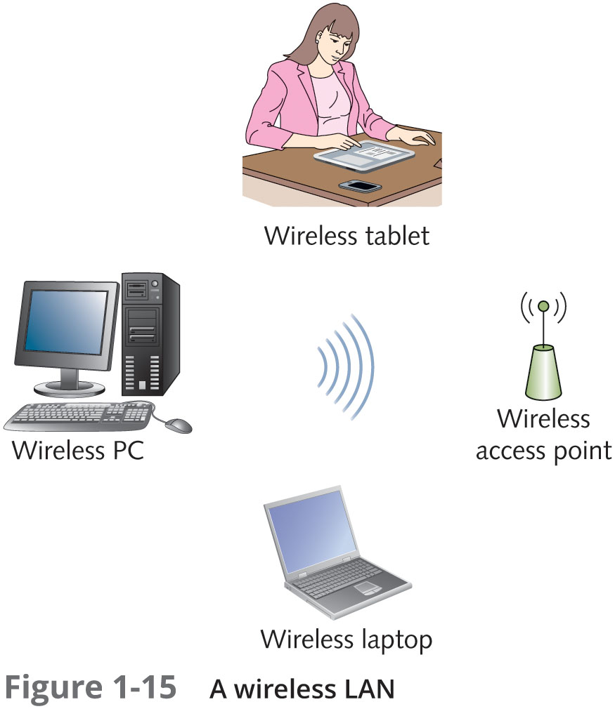
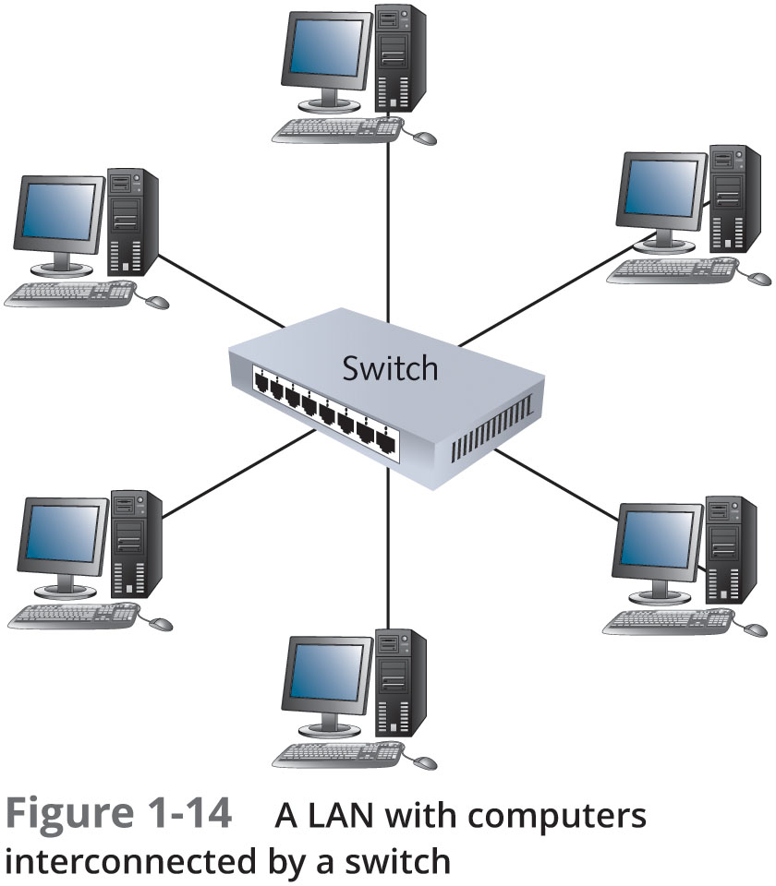
LANs, Internetworks, WANs, and MANs

Slide 15
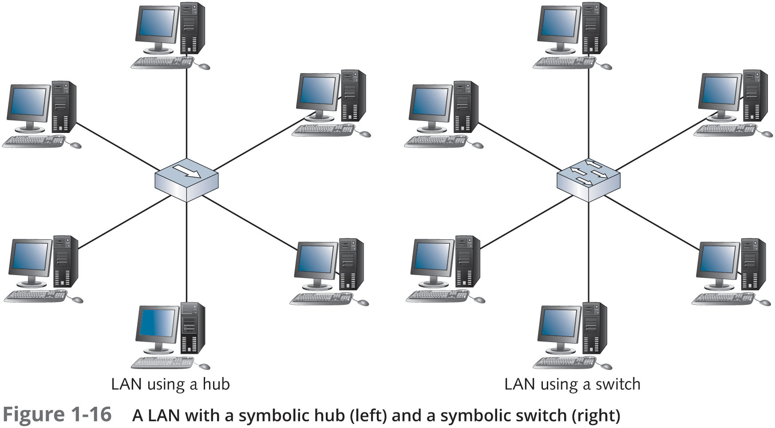
LANs, Internetworks, WANs, and MANs

Slide 16
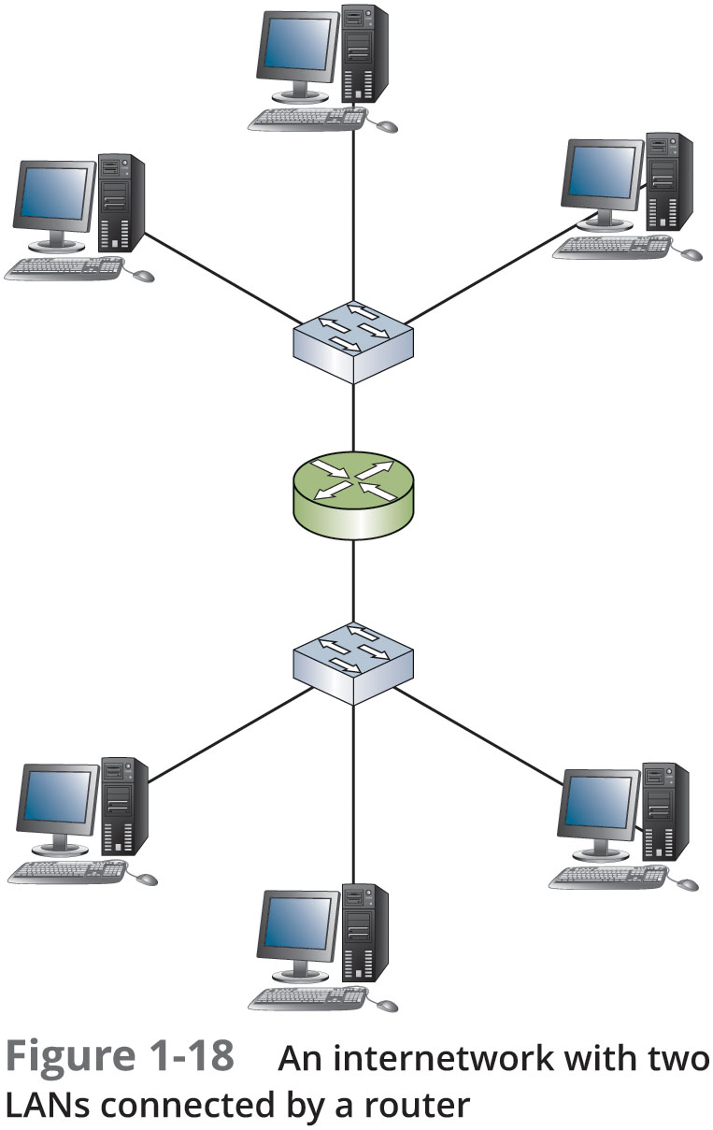
LANs, Internetworks, WANs, and MANs

Slide 17
LANs, Internetworks, WANs, and MANs
Wide area networks (WANs) use the services of third-party communication providers to carry network traffic from one location to another
Metropolitan area networks (MANs) use WAN technologies to interconnect LANs in a specific geographic region, such as a county of city

Slide 18
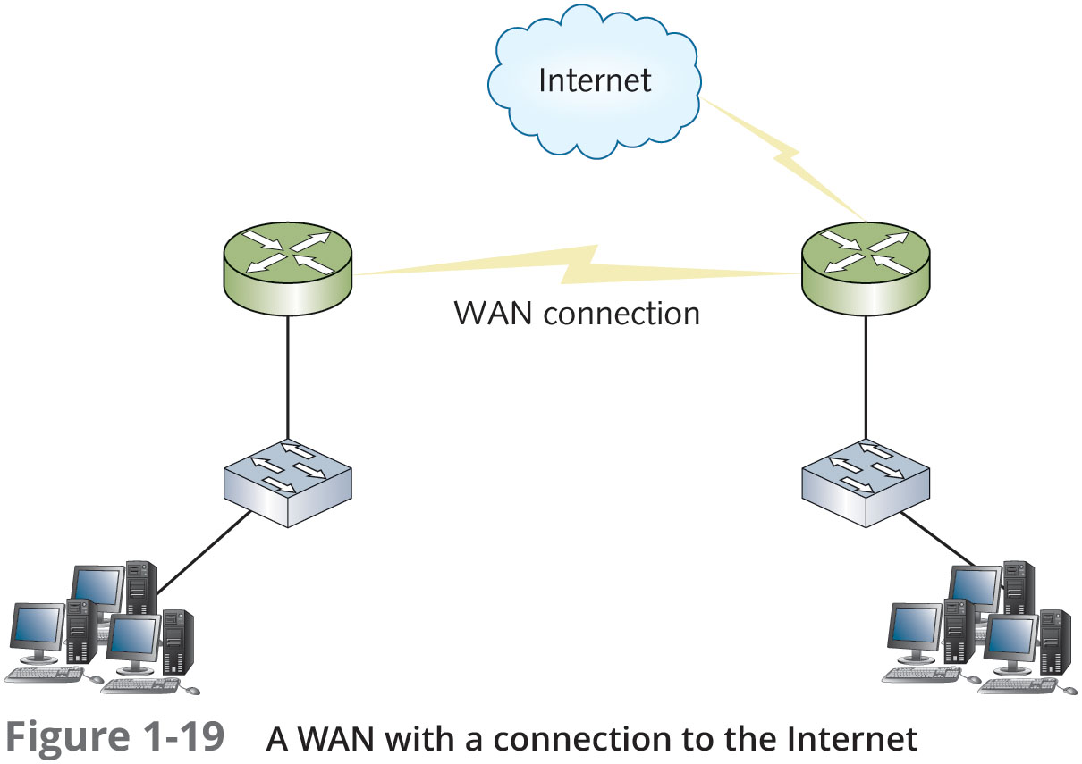
LANs, Internetworks, WANs, and MANs

Slide 19
Internet, Intranet, and Extranet
The Internet is a worldwide public internetwork
Uses protocols such as TCP/IP and HTTP to transfer and view information
An intranet is a private internetwork in which devices and servers are only available to those users connected to the internal network
An extranet allows limited and controlled access to internal resources by outside users

Slide 20
Packets and Frames
Computers transfer information across networks in shorts bursts of about 1500 bytes of data
Reasons data is transferred this way:
Pause between bursts allows other computers to transfer data during pauses
Allows the receiving computer to process received data
Allows the receiving computer receive data from other computers at the same time
Gives the sending computer an opportunity to receive data from other computers and perform other processing tasks
If an error occurs during transmission of a large file, only the chunks of data involved in the error have to be sent again

Slide 21
Packets and Frames
Packets
Chunks of data sent across the network are usually called “packets” or “frames”, with packets being the more well-known term
Packet is a chunk of data with a source and destination IP address added to it
Using the U.S. mail analogy, you can look at a packet as an envelope that has had the zip code added to the address but not the street address
Frames
Frame is a packet with the source and destination MAC addresses added to it
The packet is “framed” by the MAC addresses on one end and an error-checking code on the other
The process of adding IP addresses and MAC addresses to chunks of data is called encapsulation
Information added to the front of the data is called a header and information added to the end is called a trailer

Slide 22
Clients and Servers
A client can be a workstation running a client OS or it can refer to the network software on a computer that requests network resources from a server
Client
The word “client” is usually used in these three contexts:
Client operating - system is the OS installed on a computer
Client computer - primary role is to run user applications and access network resources
Client software - software that requests network resources from server software on another computer

Slide 23
Clients and Servers
Server
A computer becomes a server when software is installed on it that provides a network service to client computers
The term “server” is also used in three contexts:
Server operating system – OS installed on a computer designed to share network resources and provide other network services
Server computer – a computer’s primary role in the network is to give client computers access to network resources and services
Server software – responds to requests for network resources from client software

Slide 24
Network Models
A network model defines how and where resources are shared and how access to these resources is regulated
Network models fall into two major types:
Peer-to-peer network – most computers function as clients or servers (no centralized control over who has access to network resources)
Server-based network – certain computers take on specialized roles and function mainly as servers, and ordinary users’ machines tend to function mainly as clients

Slide 25
Peer-to-Peer/Workgroup Model
Computers on a peer-to-peer network can take both a client and a server role
Any user can share resources on his/her computer with any other user’s computer
Every user must act as the administrator of his/her computer
Can give everyone else unlimited access to their resources or grant restricted access to other users
Usernames and passwords (credentials) are used to control that access
Problems with peer-to-peer networks:
Must remember multiple sets of credentials to access resources on several computers
Desktop PCs and the OS installed on them aren’t made to provide network services as efficiently as dedicated network servers
Data organization
If every machine can be a server, how can users keep track of what information is stored on which machine?

Slide 26
Server/Domain-Based Model
Server-based networks allow centralized control over network resources
Users log on to the network with a single set of credentials maintained by one or more servers running a server OS
In most cases, servers are dedicated to running network services and should not be used to run user applications
A domain is a collection of users and computers whose accounts are managed by Windows servers called domain controllers
Users and computers in a domain are subject to network access and security policies defined by a network administrator
The software that manages this security is referred to as a directory service.
On Windows servers, the directory service software is Active Directory

Slide 27
Server/Domain-Based Model
Other network services found on network servers:
Naming services – translate computer names to their address
E-mail services – manage incoming and outgoing email
Application services – grant client computers access to complex applications that run on the server
Communication services – give remote users access to a network
Web services – provide comprehensive Web-based application services
Server-based networks are easier to expand than peer-to-peer
Peer-to-peer should be limited to 10 or fewer users
Server-based networks can handle up to thousands of users
Multiple servers can be configured to work together which can be used to run a more efficient network or can provide fault tolerance

Slide 28
Server/Domain-Based Model
Network attribute | Peer-to-peer network | Server-based network
Resource access | Distributed among many other desktop/client computers; makes access to resources more complex | Centralized on one or more servers; streamlines access to resources
Security | Users control their own shared resources and might have several sets of credentials to access resources; not ideal when tight security is essential | Security is managed centrally, and users have a single set of credentials for all shared resources; best when a secure environment is necessary
Performance | Desktop OS not tuned for resource sharing; access to shared resources can be hindered by users running applications | Server OS tuned for resource sharing; servers are usually dedicated to providing network services
Cost | No dedicated hardware or server OS required, making initial costs lower; lost productivity caused by increasing complexity can raise costs in the long run | Higher upfront costs because of dedicated hardware and server OSs; additional ongoing costs for administrative support
strengths and weaknesses of peer-to-peer and server-based networks

Slide 29
Summary
All computers perform three basic tasks: input, processing, and output
Storage is a major part of a computer’s configuration
Components needed to make a stand-alone computer a networked computer include a NIC, a network medium, and usually an interconnecting device
Also client/server software, protocols, and NIC driver
The layers of the network communication process can be summarized as user application, network software, network protocol, and network interface

Slide 30
Summary
The four terms used to describe networks of different scope are LAN, Internetwork, WAN, and MAN
Packets and frames are the units of data handled by different network components
Packets have the source and destination IP address added and are processed by the network protocol
Frames have the MAC addresses and an error code added and are processed by the network interface
A client is the computer or network software that requests network data and a server is the computer or network software that makes the network data available to requesting clients
A peer-to-peer network model has no centralized authority over resources while a server-based network usually uses as directory service to provide centralized resource management

